Slide 1

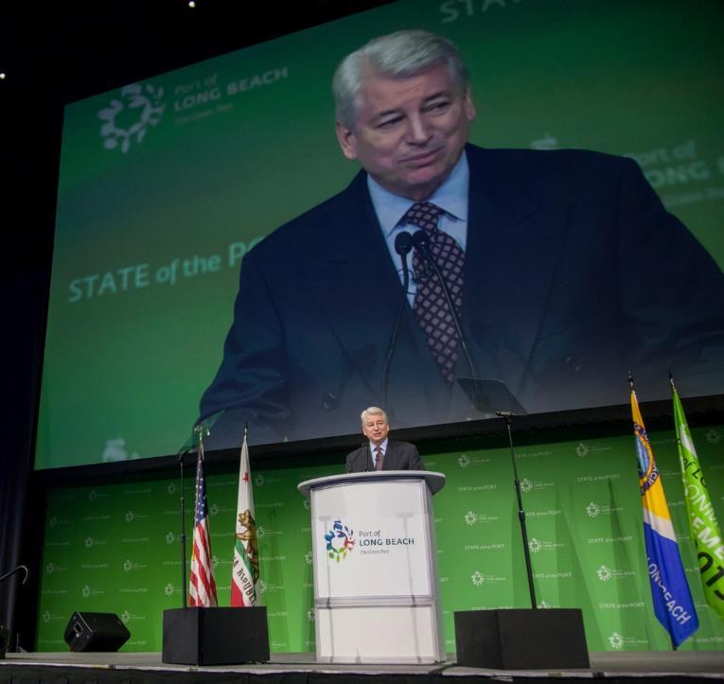
Port of
Long Beach
State of the Port Event
Special Events

